Slide 1
MCP :Containerization & Connection

Slide 2
Agenda
Technical Terms and System Capabilities
Key Benefits of MCP
Limitations and Industry Challenges
Real-World Use Cases
Technical Illustration of Server Example
Future Outlook & Resources

Slide 3
Technical Terms and System Capabilities
Tools: Executable actions (API calls, database queries)
Resources: Data files, context objects
Prompts: Structured task templates for LLMs
Life-cycle management: Session initiation, connection teardown
Subscription management: Real-time notifications when resources change.

Slide 4
Key Benefits of MCP
Statefulness: Maintains session/context for complex workflows.
Flexibility: Adapts to available tools/resources.
Security: Isolates each client-server connection, manages permissions centrally.
Developer Experience: Reduced integration code, universal adapter style.

Slide 5
Limitations and Industry Challenges
Security: Risk of exposing sensitive resources if server misconfigured.
Data leakage: Controlled data injection into LLM prompts required.
Standardization: Underlying protocol evolving, not yet uniformly adopted.
Tool naming conventions: Avoiding hallucination, clear boundaries needed.

Slide 6
Real-World Use Cases
AI agent updating CRM and ordering system via MCP.
LLM assistant interacts with Slack, Linear, and Notion through MCP servers.
Workflow orchestration for customer support, knowledge base queries.
When to Use MCP
When agentic, multi-system, context-rich workflows are required.
Ideal for live tool chaining, multi-modal information retrieval.

Slide 7
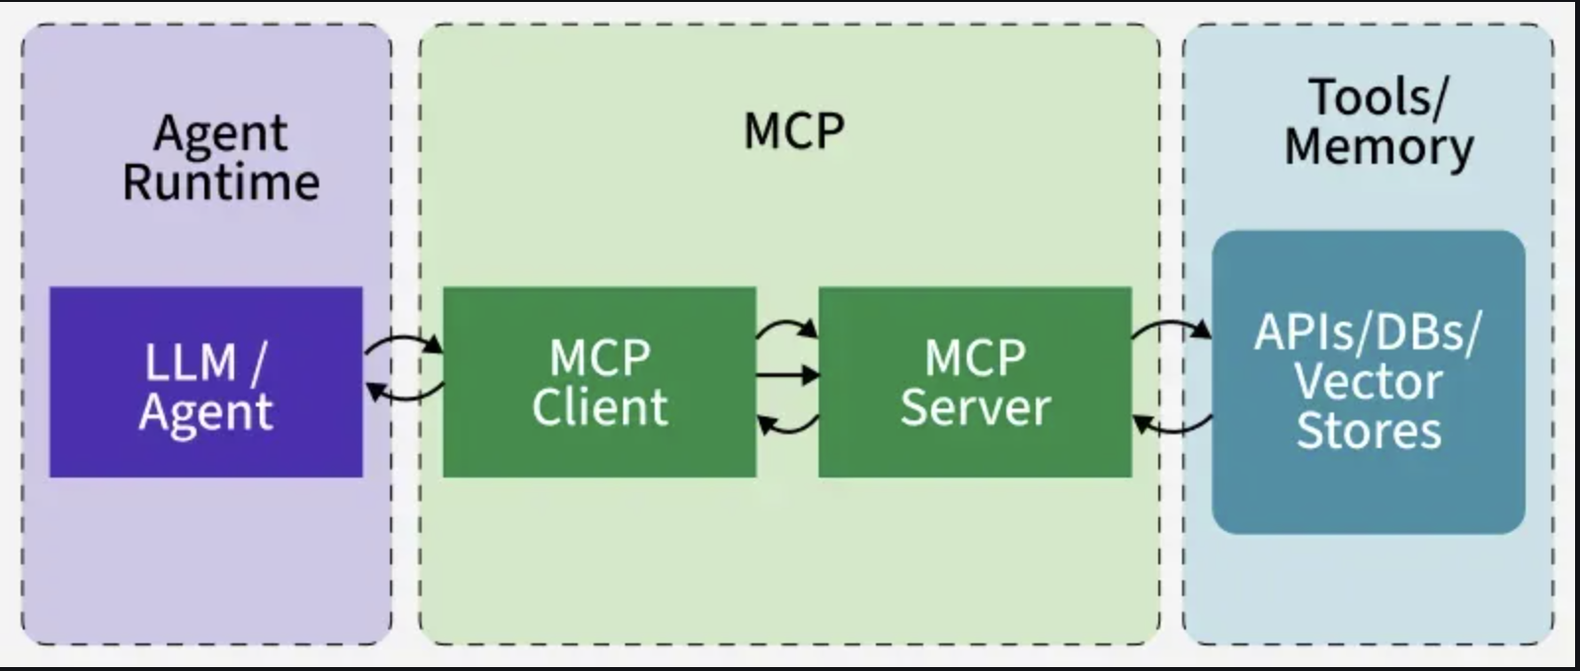
Technical Illustration of Server Example
Example server interface:
Registers available tools (e.g., memory.search).
Receives JSON-RPC requests, processes, responds with results.
Connects to databases, file stores, or cloud APIs behind the scenes.

Slide 8
Future Outlook & Resources
Industry convergence on MCP for scalable AI tool integration.
Enhanced security features and universal SDKs in development.
Growth in open-source server/client libraries
References & Further Reading
Official MCP documentation and architecture guides
Industry blog case studies, workflow visualizations
Example code repositories for MCP servers and clients.

Slide 9
Hands On – Outcomes
Explain why containerisation is useful for MCP servers.
Describe MCP tools, resources, prompts and lifecycle as system capabilities.
Build and run a Docker image for an MCP server.
Connect an MCP host/client to a containerised MCP server.
Discuss benefits and limitations of MCP in production.

Slide 10
HRLeaveManager – A Realistic MCP Server
Backed by SQLite with tables for employees, leave records, and leave balance history.
Tools include: add/remove employee, update_leave_balance, apply_leave, list_employees.
Reporting tools: get_department_summary, get_recent_leave_activity.
Prompts: hr_dashboard_prompt, leave_report_prompt for richer LLM outputs.
Closer to a real HR system than the in-memory example from the first MCP session.

Slide 11
Installing an MCP Server with mcp[cli]
Dependencies: mcp[cli] is declared in pyproject.toml.
Use the `uv` tool (or plain Python) to run the MCP CLI.
Conceptual example: `uv run mcp install main_v2.py` to register the server.
Once installed, MCP-aware hosts can discover and call this server’s tools.
Exact command may vary by environment; adapt for your lab machines.

Slide 12
Dockerizing HRLeaveManager – Example Dockerfile
FROM python:3.13-slim WORKDIR /app # Copy project metadata and install dependencies COPY pyproject.toml README.md ./ RUN pip install uv && uv sync --no-dev # Copy source code COPY . . # Expose MCP server entrypoint CMD ["uv", "run", "python", "main_v2.py"]

Slide 13
Building and Running the Container
From the project root, build the image:
docker build -t hr-leave-mcp .
Run the container:
docker run --rm -p 8080:8080 hr-leave-mcp
Bind ports or use STDIO according to how your MCP client connects to servers.
Use a volume for the SQLite DB if you need to persist data across container restarts.

Slide 14
Security & Data Protection for MCP Servers
Expose only the tools and tables you want the LLM to access.
Avoid embedding sensitive fields in prompts and tool outputs unnecessarily.
Use environment variables or secret stores for credentials and API keys.
Log tool calls (within policy) for auditability and debugging.
Restrict network access to the MCP server within internal or sandboxed environments.

Slide 15
Lab – Containerise & Connect HRLeaveManager
Goal: go from Python script to containerised MCP service.
Tasks:
Build a Docker image for main_v2.py using the example Dockerfile.
Run the container and confirm the server starts correctly.
From an MCP host/client, call list_employees and get_department_summary.
Discuss what would change between development, staging and production deployments.

Slide 16
Preparing for Case Study 2
Think like HR stakeholders: what additional capabilities would they ask for?
Examples: approval workflows, stricter validation, export tools, manager views, insights.
In the Case Study 2 session, teams will extend HRLeaveManager to cover some of these needs.
You will design new tools/prompts and run them in a containerised environment.

Slide 17
Thank You
(Q&A)

